Slide 1
SystemVerilog HDL Workshop #5
044252 - Digital Systems and Computer Structure

Slide 2
Agenda
FSM – reminder
Control and datapath
UART – reminder
Summarizing example

Slide 3
Agenda
FSM – reminder
Control and datapath
UART – reminder
Summarizing example

Slide 4
Reminder – What is FSM?

Slide 5
FSM – Writing Code
Declare states used for FSM
Write FSM using two procedural blocks:
Synchronous – saves current state
Asynchronous – sets next state and output signals (according to current state and optionally input signals)
Other helper procedural blocks can also be used

Slide 6
FSM Template
module my_FSM_module (
input logic input1,
...
output logic outputN
;(
// Declaring the FSM states
typedef enum { idle_st, start_st } sm_type;
// Declaring signals for the next & current state
sm_type current_state;
sm_type next_state;
// ...
endmodule

Slide 7
FSM – Synchronous Logic
// FSM synchronous procedural block. always_ff @(posedge clk, posedge rst) begin if (rst == 1'b1) begin current_state <= idle_st; end else begin current_state <= next_state; end end

Slide 8
FSM – Async Logic
always_comb begin
next_state = current_state;
output1 = 1'b0;
...
outputN = 1'b0;
case (current_state)
idle_st: begin
next_state = ...;
output1 = ...;
...
outputN = ...;
end
start_st: begin
next_state = ...;
output1 = ...;
...
outputN = ...;
end
...
endcase
end
Default Assignments

Slide 9
Agenda
FSM – reminder
Control and datapath
UART – reminder
Summarizing example

Slide 10
Control and Datapath Separation
Signals are classified into two categories:
Data
Usually buses (wide vectors)
Common units: FAs, mux, ALU, …
Control
Usually single bits
Common units: FSM
Data In
Data Out
Data Processor
Status
Control
External Status
Controller
External Control

Slide 11
Agenda
FSM – reminder
Control and datapath
UART – reminder
Summarizing example

Slide 12
תקשורת על חוט יחיד
חוט טלפון, רשת מקומית, ...
במקום חוטי REQ, ACK:
נשתמש בשעון איטי הרבה יותר מהשעונים הפועלים בשני הקצוות
נסנכרן אותם מידי פעם:
גם זו קרויה "תקשורת אסינכרונית" אבל בעצם היא קצת סינכרונית
פרוטוקול תקשורת UART: Universal (Synchronous) Asynchronous Receiver/Transmitter
נהוג ביציאת COM של ה-PC
אפשרות אחרת (נהוגה ברשת מקומית מהירה): נקודד את השעון יחד עם הנתונים, למשל “Manchester Code”

Slide 13
UART – Transmitter FSM

Slide 14
Agenda
FSM – reminder
UART – reminder
Summarizing example

Slide 15
UART3 Protocol
In this workshop, we will plan a UART transmitter with a few minor changes:
3-bit word instead of an 8-bit word
Sends a parity bit
Tx transmitter
stop | stop | stop | parity | parity | parity | bit3 | bit3 | bit3 | bit2 | bit2 | bit2 | bit1 | bit1 | bit1 | start | start | start
baud time

Slide 16
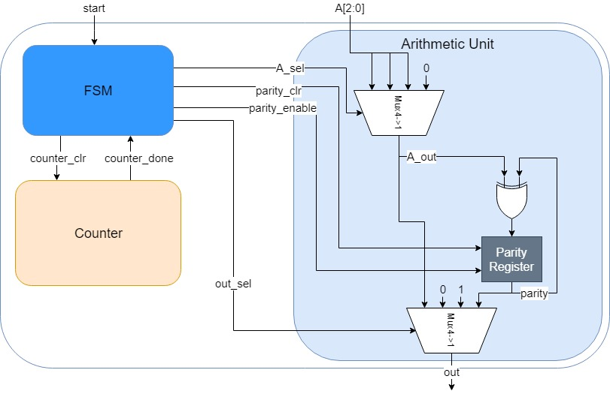
Summarizing Example: UART3

Slide 17
Top Level and Signal Declarations
module UART3 (
input logic clk,
input logic rst,
input logic [2:0] A,
input logic start,
output logic out
;(
parameter N = 3;
logic counter_done;
logic counter_clear;
logic [1:0] A_sel;
logic [1:0] out_sel;
logic parity_clr;
logic parity_enable;
UART3_fsm fsm_u(
.clk(clk),
.rst(rst),
.start(start),
.counter_done(counter_done),
.counter_clear(counter_clear),
.A_sel(A_sel),
.out_sel(out_sel),
.parity_clr(parity_clr),
.parity_enable(parity_enable)
;(
UART3_counter #(
.N(N)
) cnt_u (
.clk(clk),
.rst(rst),
.counter_clear(counter_clear),
.counter_done(counter_done)
;(
UART3_arith arith_u(
.clk(clk),
.rst(rst),
.A(A),
.A_sel(A_sel),
.out_sel(out_sel),
.parity_clr(parity_clr),
.parity_enable(parity_enable),
.out(out)
);
endmodule

Slide 18
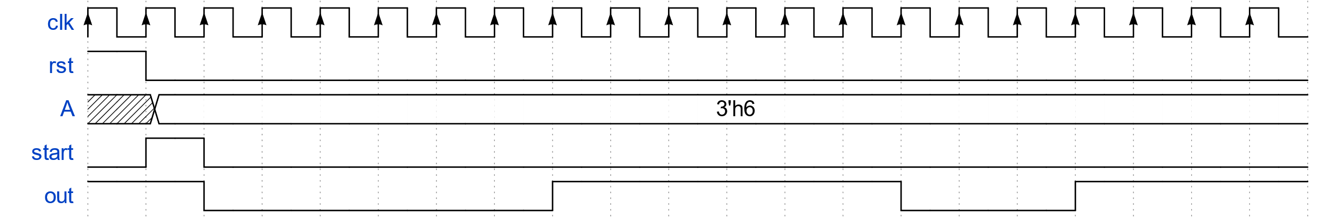
Simulations – Top Level
start
A[0]
A[1]
A[2]
parity
stop

Slide 19
Building the FSM
Build a Mealy FSM
Requirements:
Receives several signals:
clk
rst (asynchronous)
start
counter_done
Outputs:
parity_clr
parity_enable
A_sel
out_sel
counter_clr

Slide 20
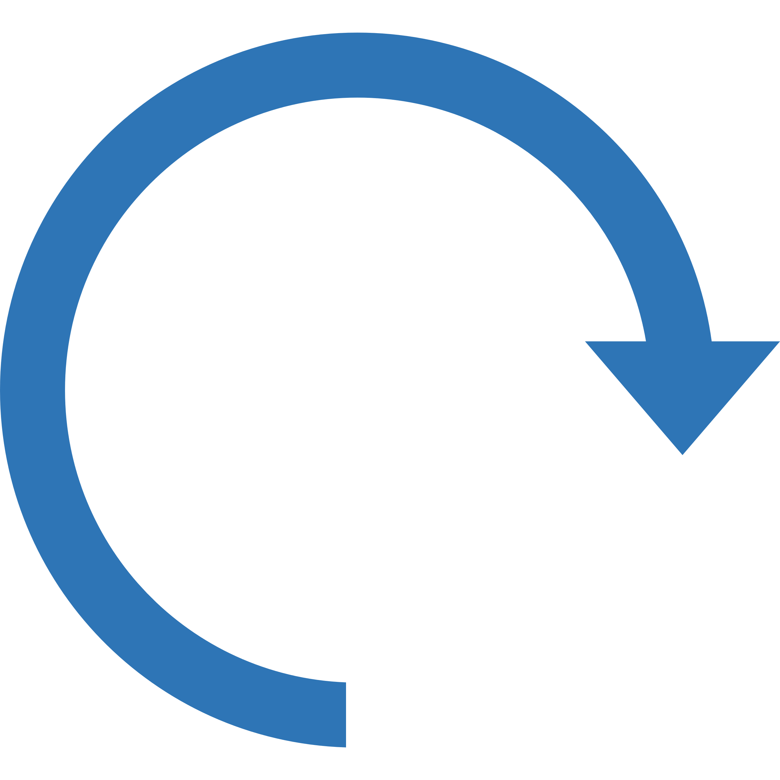
UART3: FSM Design
Defaults:
parity_clr = 0
A_sel = 0
out_sel = 2
counter_clr = 1
parity_enable = 0
!counter_done /
counter_clr=0
out_sel=1
!counter_done /
counter_clr=0
out_sel=0
Start == 0
rst
Idle
start == 1 /
parity_clr=1
Start bit
counter_done /
out_sel=1
First bit
counter_done && start == 1 /
parity_clr=1
counter_done && start == 0
counter_done /
parity_enable=1
out_sel=0
!counter_done /
counter_clr=0
out_sel=0
A_sel=2
Stop bit
counter_done /
parity_enable=1
out_sel=0
A_sel=1
!counter_done /
counter_clr=0
counter_done /
parity_enable=1
out_sel=0
A_sel=2
Second bit
Third bit
counter_done /
out_sel=3
Parity
!counter_done /
counter_clr=0
out_sel=0
A_sel=1
!counter_done /
counter_clr=0
out_sel=3

Slide 21
FSM
module UART3_fsm ( input logic clk, input logic rst, input logic start, input logic counter_done, output logic counter_clear, output logic [1:0] A_sel, output logic [1:0] out_sel, output logic parity_clr, output logic parity_enable ); typedef enum { idle_st, start_bit_st, first_bit_st, second_bit_st, third_bit_st, parity_st, stop_bit_st } sm_type; sm_type current_state; sm_type next_state;

Slide 22
FSM – Synchronous Logic
// FSM synchronous procedural block. always_ff @(posedge clk, posedge rst) begin if (rst == 1'b1) begin current_state <= idle_st; end else begin current_state <= next_state; end end

Slide 23
FSM – Async Logic
always_comb begin next_state = current_state; parity_clr = 1'b0; A_sel = 2'd0; out_sel = 2'd2; counter_clear = 1'b1; parity_enable = 1'b0; case (current_state) idle_st: begin if (start == 1'b1) begin next_state = start_bit_st; parity_clr = 1'b1; end end start_bit_st: begin out_sel = 2'd1; if (counter_done) begin next_state = first_bit_st; end else begin counter_clear = 1'b0; end end
first_bit_st: begin out_sel = 2'd0; if (counter_done) begin next_state = second_bit_st; parity_enable = 1'b1; end else begin counter_clear = 1'b0; end end second_bit_st: begin out_sel = 2'd0; A_sel = 2'd1; if (counter_done) begin next_state = third_bit_st; parity_enable = 1'b1; end else begin counter_clear = 1'b0; end end

Slide 24
FSM – Async Logic
third_bit_st: begin out_sel = 2'd0; A_sel = 2'd2; if (counter_done) begin next_state = parity_st; parity_enable = 1'b1; end else begin counter_clear = 1'b0; end end parity_st: begin out_sel = 2'd3; if (counter_done) begin next_state = stop_bit_st; end else begin counter_clear = 1'b0; end end
stop_bit_st: begin if (counter_done) begin if (start == 1'b0) begin next_state = idle_st; end else begin next_state = start_bit_st; parity_clr = 1'b1; end end else begin counter_clear = 1'b0; end end

Slide 25
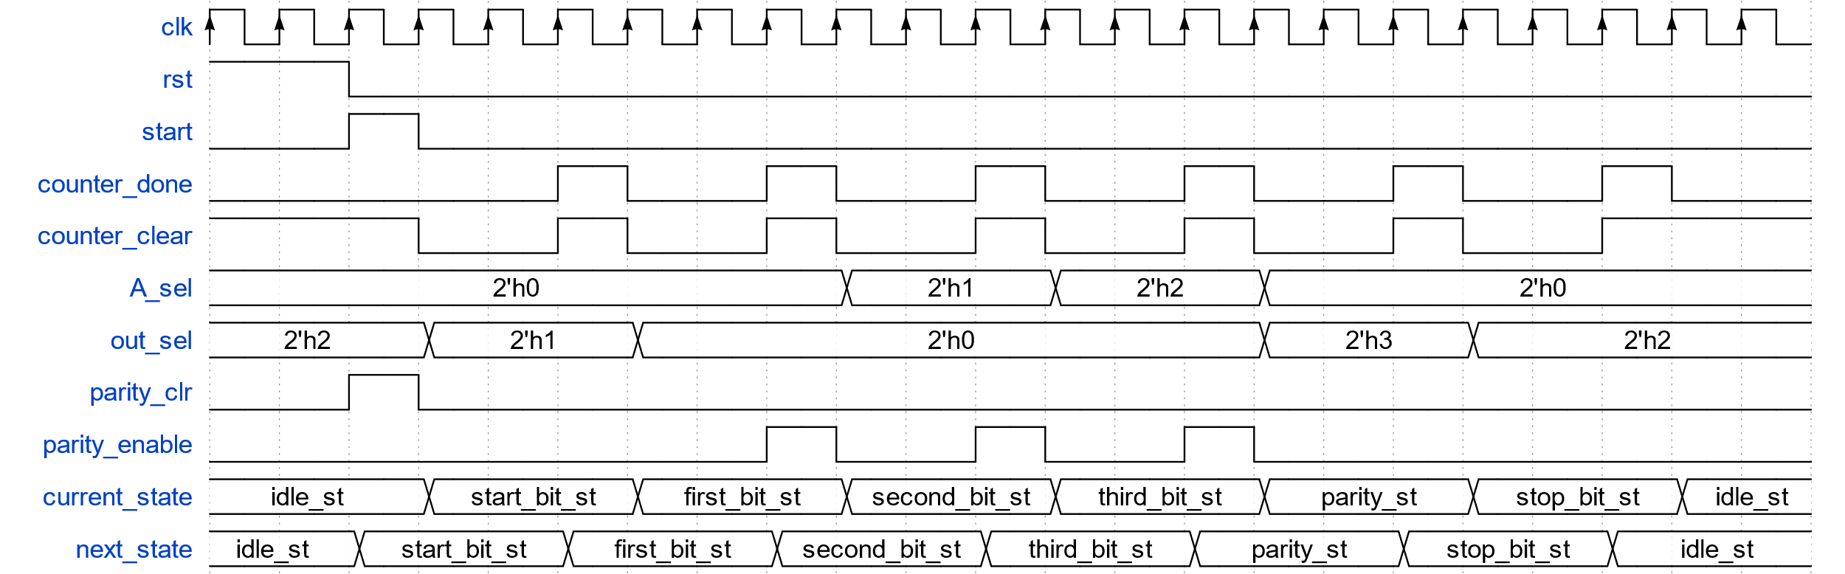
Simulations – FSM

Slide 26
Arithmetic Unit
module UART3_arith (
input logic clk,
input logic rst,
input logic [2:0] A,
input logic [1:0] A_sel,
input logic [1:0] out_sel,
input logic parity_clr,
input logic parity_enable,
output logic out
);
logic parity;
logic A_out;
// A mux
always_comb begin
case (A_sel)
2'd0: A_out = A[0];
2'd1: A_out = A[1];
2'd2: A_out = A[2];
default: A_out = 1'b0;
endcase
end
// Out mux
always_comb begin
case (out_sel)
2'd0: out = A_out;
2'd1: out = 1'b0;
2'd2: out = 1'b1;
2'd3: out = parity;
default: out = 1'b0; // For simulation only
endcase
end
// Parity register
always_ff @(posedge clk, posedge rst) begin
if (rst == 1'b1) begin
parity <= 1'b0;
end
else begin
if (parity_clr == 1'b1) begin
parity <= 1'b0;
end
else if (parity_enable == 1'b1)
begin
parity <= parity ^ A_out;
end
end
end
endmodule

Slide 27
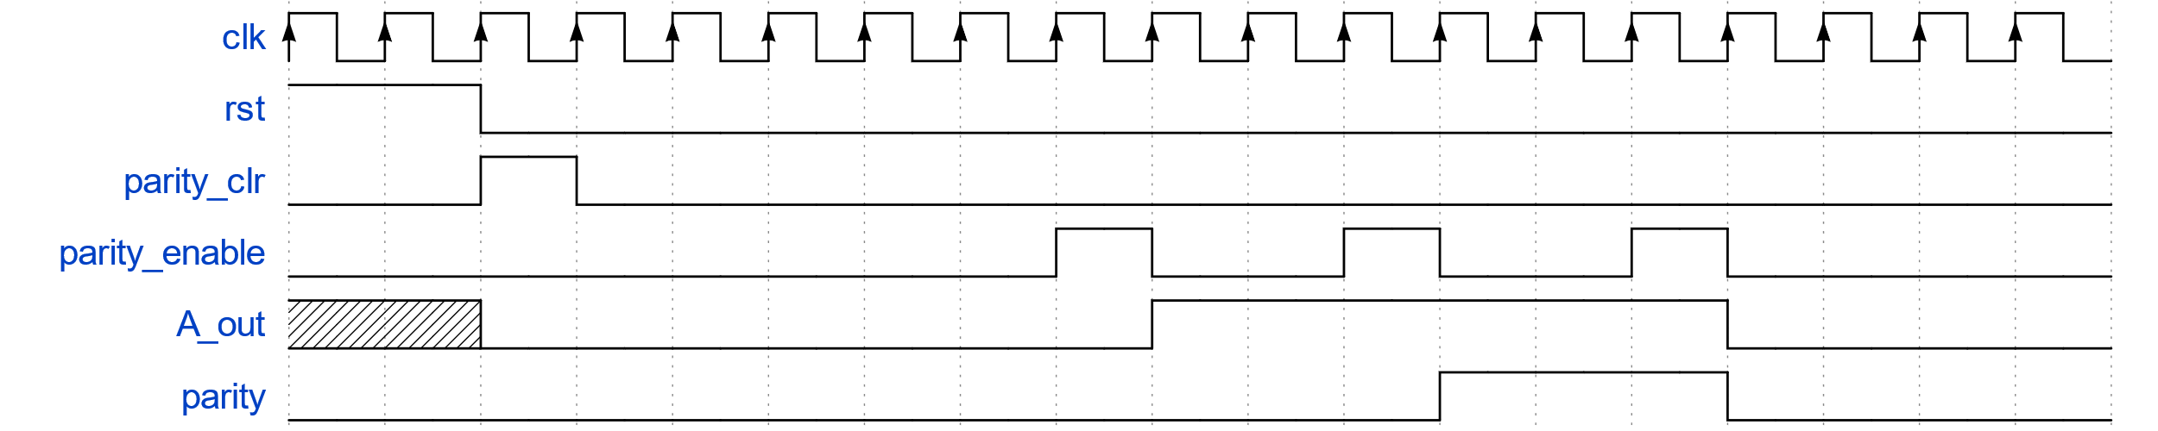
Simulations – Parity

Slide 28
Counter
module UART3_counter (
input logic clk,
input logic rst,
input logic counter_clear,
output logic counter_done
);
parameter N = 3;
logic [31:0] counter;
always_ff @(posedge clk, posedge rst) begin
if (rst == 1'b1) begin
counter <= 32'd0;
end
else begin
if (counter_clear == 1'b1) begin
counter <= 32'd0;
end
else if (counter < N - 1) begin
counter <= counter + 1;
end
end
end
always_comb begin
if (counter == N - 1) begin
counter_done = 1'b1;
end
else begin
counter_done = 1'b0;
end
end
endmodule

Slide 29
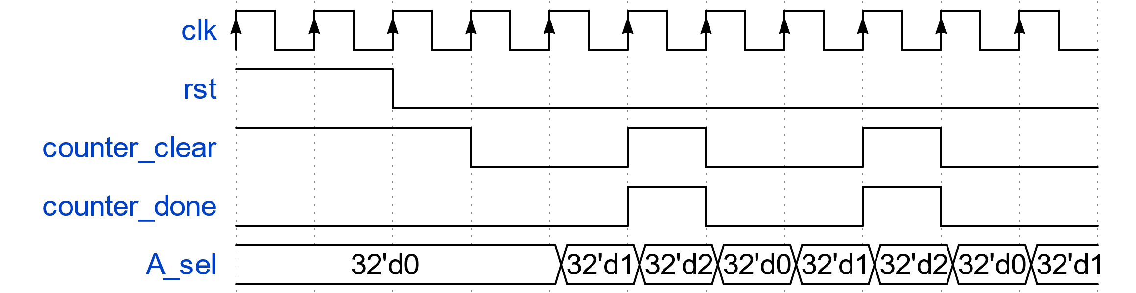
Simulations – Counter

Slide 30
Test Bench
module UART3_test; logic clk; logic rst; logic [2:0] A; logic start; logic out; UART3 #(.N(3)) uart ( .clk(clk), .rst(rst), .A(A), .start(start), .out(out) ;( initial begin clk = 1'b0; 5# rst = 1'b1; 10# rst = 1'b0; A = 3'b110; start = 1'b1; end always begin 5# clk = ~clk; end endmodule

Slide 31
The Full Code
The full code is supplied with the workshop files
UART3_fsm.sv
UART3.sv
UART3_test.sv
UART3_fsm fsm_u (…);
UART3_counter counter_u(…);
UART3_arith arith_u(…);
UART3 uart3 (…);
UART3_counter.sv
UART3_arith.sv

Slide 32
Debugging Tips Video
Hardware debugging is different than software debugging
Waveform vs. tests / debug prints
The workshop code is supplied with a video which explains about debugging hardware
Common mistakes
How to track bugs using a waveform

Slide 33
Exam Question
After reset, how many clock cycles are between two rises of out signal?
module mymodule2 (
input logic clk,
input logic rst,
output logic out
;(
logic w1;
logic w2;
mymodule uut1 (clk, rst, w1);
mymodule #(.N(2)) uut2 (clk, rst, w2);
always_comb begin
if ((w1 == 1'b1) && (w2 == 1'b1)) begin
out = 1'b1;
end
else begin
out = 1'b0;
end
end
endmodule

Slide 34
Exam Question
module mymodule (
input logic clk,
input logic rst,
output logic done
;(
parameter N = 3;
logic [31:0] w;
always_ff @(posedge clk, posedge rst)
begin
if (rst == 1'b1) begin
w <= 32'd0;
end
else begin
if (w < N - 1) begin
w <= w + 1;
end
else if (w == N - 1) begin
w <= 0;
end
end
end
always_comb begin
if (w == N - 1)
begin
done = 1'b1;
end
else begin
done = 1'b0;
end
end
endmodule

Slide 35
The Exam
One multiple-choice question (~5 points)
Questions from previous exams are partially irrelevant (Verilog/VHDL)
Preparation questions are in Moodle
The material from the workshops and wet exercises is important. Implementation details from the wet exercises are not!
We are available for questions in the Moodle forum

Slide 36
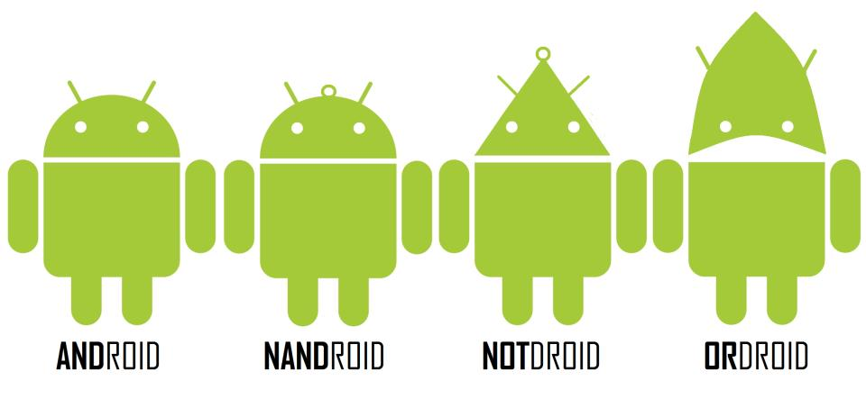
Questions?

